Slide 1
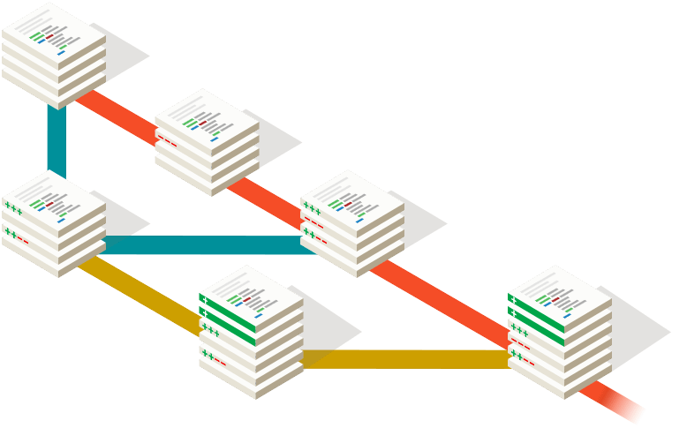
Introduction to Github
Don’t Git scared, Git started
November 19, 2016
Imad Hsissou, ENSA Marrakech, UCA
imad.hsissou@edu.uca.ma

Slide 2
Goals
Be familiar with Version Control Systems *
Basic understanding of how Git operates
Can use basic Git commands and know what they do to the filesystem
Learn how to contribute on Github
* Don’t panic, I’ll explain everything ☺

Slide 3

What is
?

Slide 4
Git is a Distributed Version Control System *
Originally developed by Linus
Torvalds (Linux Emperor !)
Very easy to learn
Designed to handle everything from small to very large projects with speed and efficiency.
* Again, don’t panic, I’ll explain everything ☺

Slide 5
What is a Version Control System ?

Slide 6
About Version Control
A system that records changes to a file or set of files over time so that you can recall specific versions later.
It allows you to revert files back to a previous state.
revert the entire project back to a previous state.
compare changes over time.
see who last modified something.
who introduced an issue and when.
and more …

Slide 7
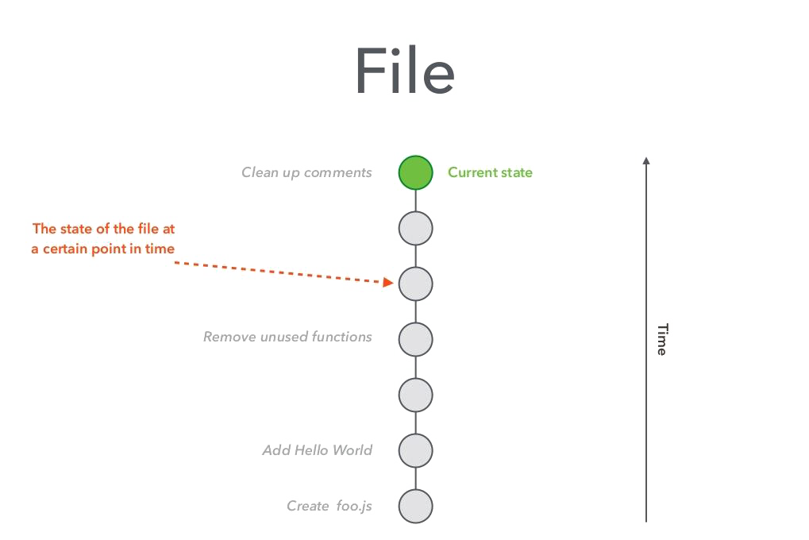

Slide 8
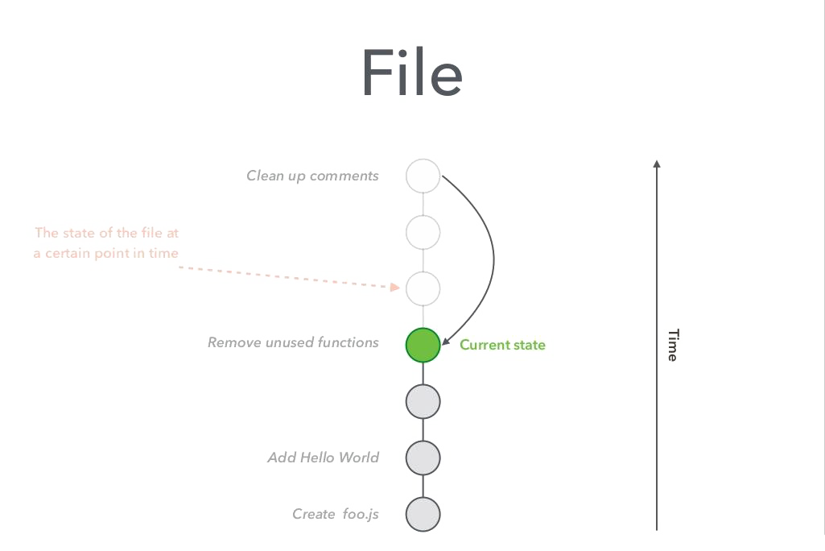

Slide 9
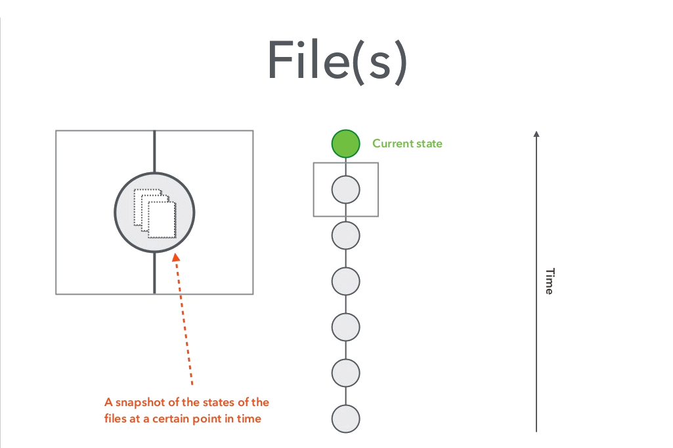

Slide 10
What is a Distributed Version Control System ?

Slide 11

Local version control

Slide 12
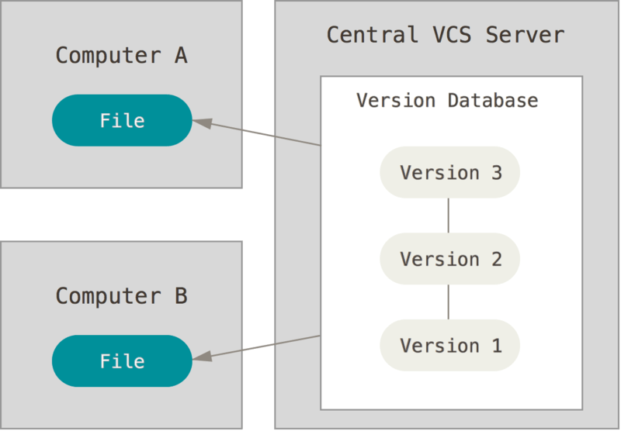
Centralized version control

Slide 13
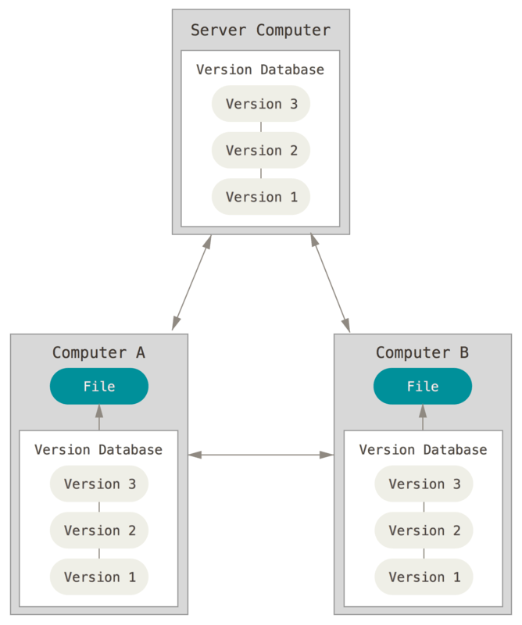
Distributed Version Control

Slide 14
Git Commands

Slide 15
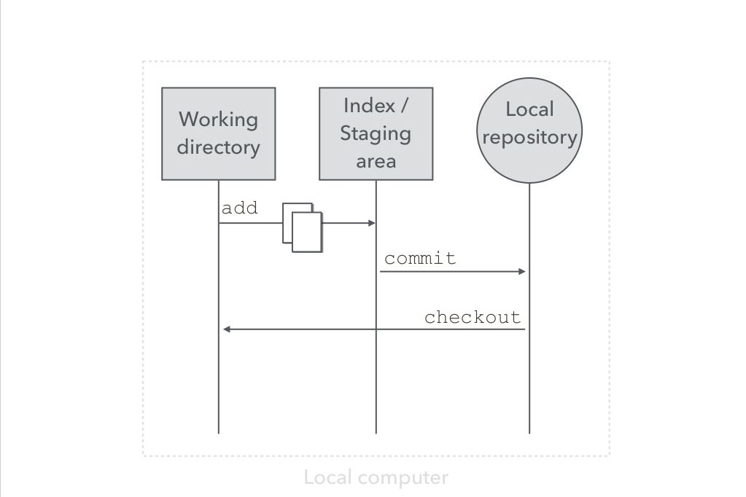

Slide 16
Working directory Files on your computer (file system)
Index / Staging area Set of files to be included in the next snapshot
Repository Database of snapshots

Slide 17
Start a new project $ git init

Slide 18
Common Git Commands
Git Command
$ git status | Review what changes you’ve made.
$ git add <files> | Tell Git that a file is to be included in the next snapshot
$ git commit <files> | Store a snapshot in the local repository

Slide 19
Inside a Commit
Commit Reference (SHA-1 checksum)
Author
Date
Message
Reference to parent commit(s)
Tree Includes the references to all the files in the snapshot

Slide 20
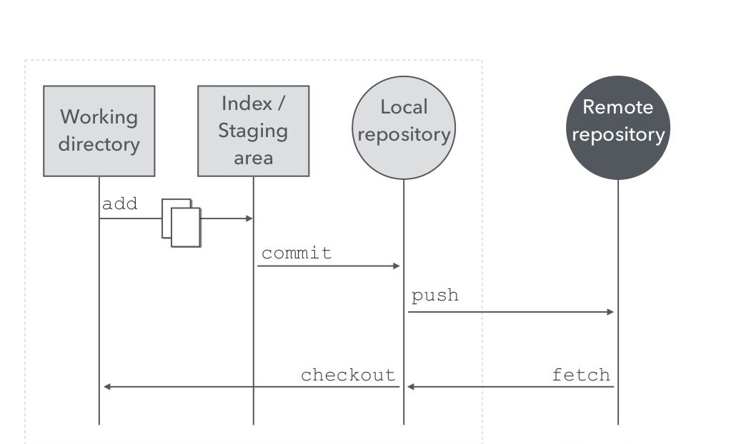

Slide 21
Common Git Commands
Git Command
$ git pull | Pull down and merge commits from a remote repository.
$ git push <remote> | Push commits to a remote repository.
$ git remote | Listes all remotes that you have configured.

Slide 22
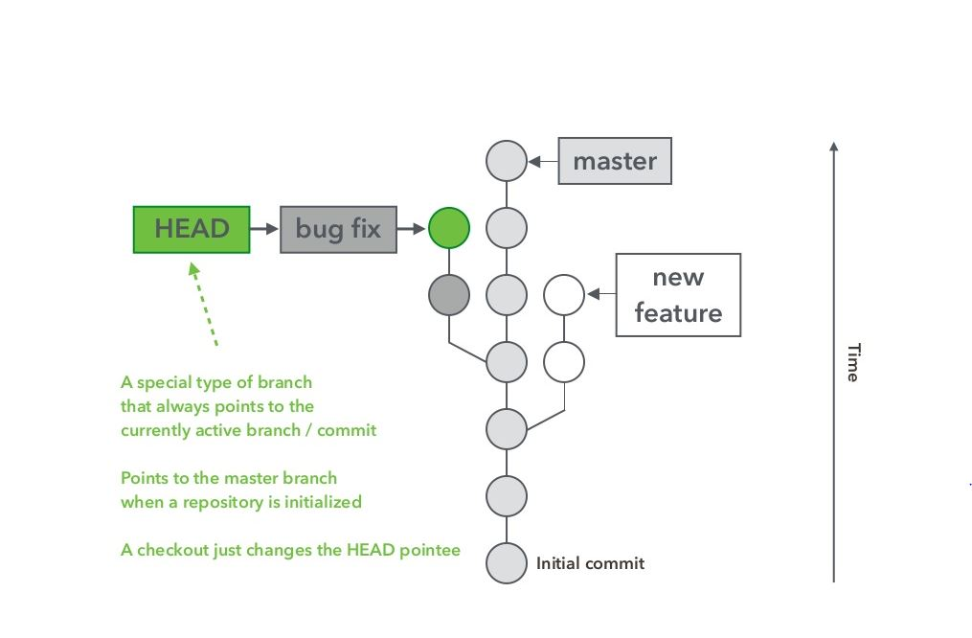
Branch

Slide 23
Merge
Merge two commits together
Can be used to merge branches
$ git merge <branch>

Slide 24
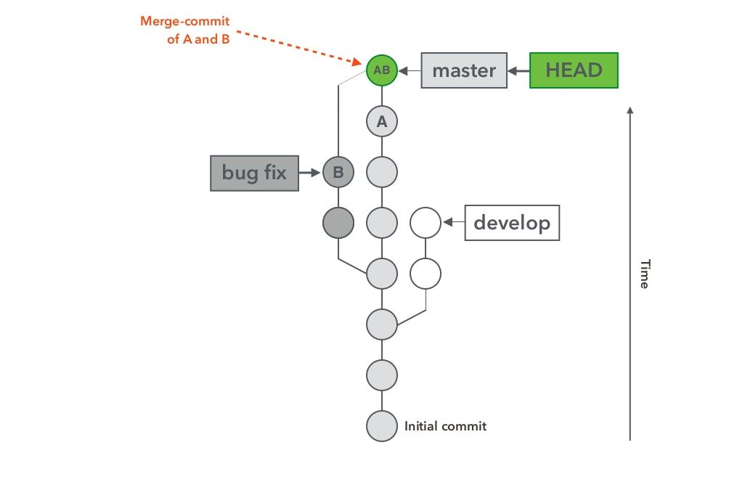

Slide 25

What is Github ?

Slide 26

is a web-based Git repository hosting service

Slide 27
Is the largest host of source code in the world

